Slide 1
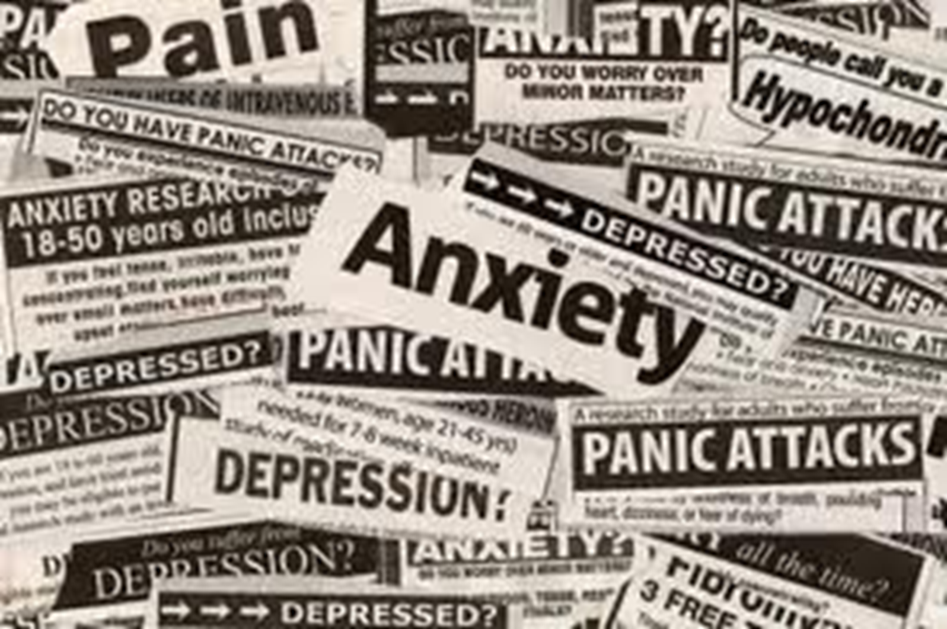

Slide 2
Mental Illness
Mental health is also sometimes referred to as emotional health. It is related to the health of your mind.
A person with good mental health will often have good self esteem, be able to handle stressful situations and generally feel happy with the direction of their life.

Slide 3
Mental illness is often a misunderstood health problem. Many associate mental illness with crazy and psychotic people - as is often portrayed in movies.
As with many other examples of human behaviour shown in films, this is not 'true life', and sufferers of mental illness are often made to feel second rate citizens.

Slide 4
The human body does not function to its full capability at all times, and this is the case with the mind too.
Mental illness is a term used to describe a vast array of different conditions which cause people to think or behave in a manner that is not considered within the realms of normality by others

Slide 5
Anxiety
Anxiety is a normal human experience of worry or fear that can’t be brought under control easily.
An anxiety disorder is different from feeling occasionally anxious or stressed – it’s a serious condition that makes it hard for the person to cope from day to day.
One in four people will experience an anxiety disorder at some stage of their lives

Slide 6
A common anxiety illness : Phobias
Phobias are the sometimes irrational fear of elements in the surroundings by the individual
Most people have phobias, however this becomes an issue when proper functioning in society is adversely effected.

Slide 7
Types of Phobias
Animal type: fear that relates to animal or insects (e.g. fear of dogs or spiders).
Natural-Environment type: a fear associated with the natural environment (e.g. fear of thunder or heights).
Blood-Injection-Injury type: A fear associated with invasive medical procedures (e.g. injections), or by seeing blood or injury.
Situational Type: a fear of specific situations (e.g. elevators, bridges or driving).
Other: Any other Specific Phobias (e.g. fear of choking or fear of vomiting).

Slide 8
Alzheimer's disease
As brain cells die, the substance of the brain shrinks. Abnormal material builds up as “tangles” in the center of the brain cells and “plaques” outside the brain cells, disrupting messages within the brain, damaging connections between brain cells. This leads to the eventual death of the brain cells and prevents the recall of information.

Slide 9
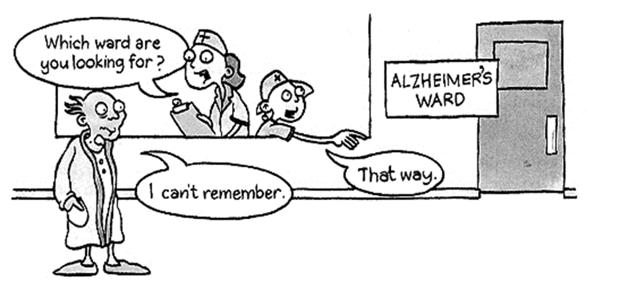
Surprisingly people assume that Alzheimer's disease only affects the elderly, however Alcohol Related Alzheimers begins may begin during late adolescence!

Slide 10
Common symptoms
loss of memory
loss of intellectual capacities
language difficulties
change in personality
irritability and depression

Slide 11
Depression
Depression is more than just a low mood – it’s a serious illness. People with depression find it hard to function every day and may be reluctant to participate in activities they once enjoyed.
Depression can have serious effects on physical and mental health. Depression is common – around 160,000 young people live with depression every year.

Slide 12
Symptoms may include
Feelings of continual unhappiness
Difficulty sleeping
lack of concentration
problems making decisions
bad temper
no enthusiasm
feelings of inability to cope

Slide 13
Self Talk
I should try...... The worst that could happen...... The best that could happen.......
The messages we give ourselves are called ‘self-talk’. Give four examples of negative self-talk

Slide 14
Now give the positive self-talk that should replace these negative messages.
I can…
I will…
I am…

Slide 15
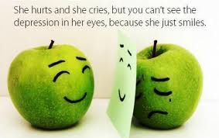
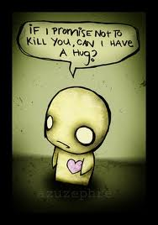
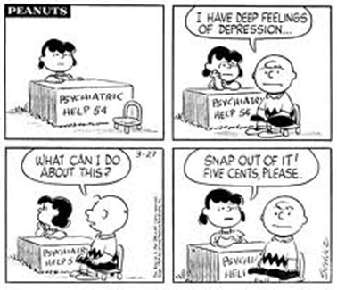
What can you do
Speak to someone you trust
Make an appointment with a GP
Access resources on the internet
Depression is not a new thing, therefore countless others have lived through it

Slide 16
Resources
Youth in Mind: www.youthinmind.net/Aus
Headroom: www.headroom.net.au
Reach Out: www.reachout.com.au
It’s All Right: www.itsallright.org
Headspace: www.headspace.org.au

Slide 17
Reference list
Beyond blue website (2012): http://www.beyondblue.org.au
Youth Beyond Blue website (2012) http://www.youthbeyondblue.com
Mental Health PowerPoint(..), Lyndhurst Secondary College

